Slide 1

Pam algorithm
Master’s degree in Artificial Intelligence
and Data Engineering
Computer architecture
University of Pisa
Students: Federico Russo Gabriele Marcuccetti

Slide 2
Summary
1) Algorithm overview
2) Parallelization and optimization
3) Execution time e speed up
4) GPU version

Slide 3
1) ALGORITHM OVERVIEW

Slide 4
PARTITIONING AROUND MEDOIDS
Partitioning Around Medoids (PAM) is a clustering algorithm utilized to partition a dataset into K groups based on the similarity of their features. It's a variation of the more well-known K-means algorithm, differing in its use of actual data points (medoids) to represent each cluster instead of centroids.
Clustering is a data analysis technique that aims to organize a dataset into homogeneous groups, where elements within each group are similar to each other and different from members of other groups.
PAM finds applications in various sectors, including social media analysis, market segmentation, bioinformatics, and more.

Slide 5
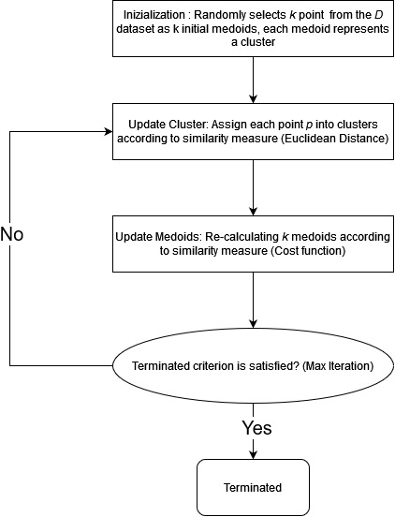
ALGORITHM
Defined:
A Similarity Measure: usually distance between points (Euclidean, Manhattan, etc.);
Termination Criterion: max number of iteration, difference between medoids;
Given:
D user dataset composed of n points;
K number of clusters that we want to find;
Out:
K medoids (center of the clusters);

Slide 6
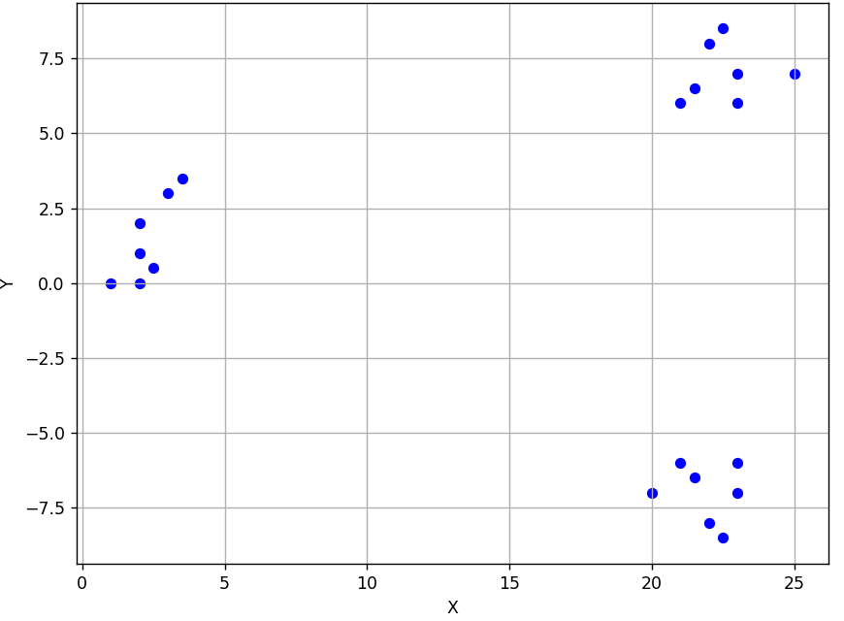
ALGORITHM
Let’s start from a set of points called «patterns» and select k initial medoids, which are the initial candidates for the most representative points in each clusters.

Slide 7
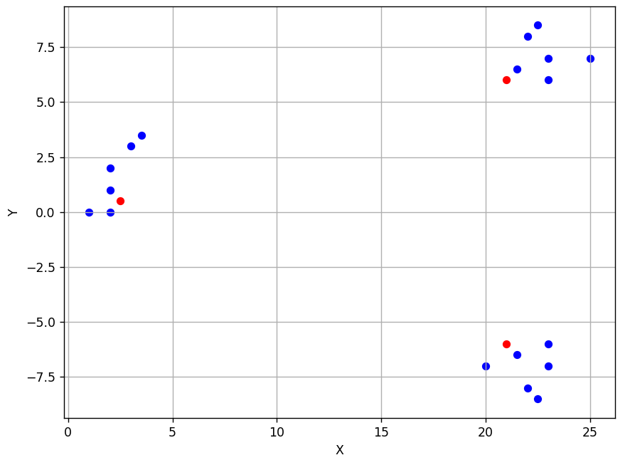
ALGORITHM
Then, assign each point in the dataset to the nearest medoid. For each cluster, try replacing the current medoid with each other point in the cluster and calculate the total cost.

Slide 8
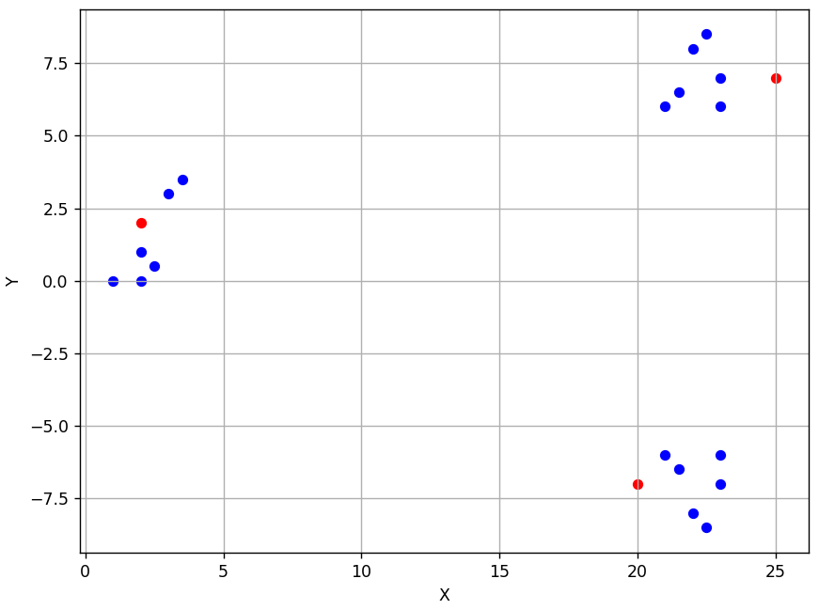
ALGORITHM
Repeat assignment and update until clustering converges or reaches a maximum number of iterations.
The bottleneck is represented by the phase of updating the centroid

Slide 9
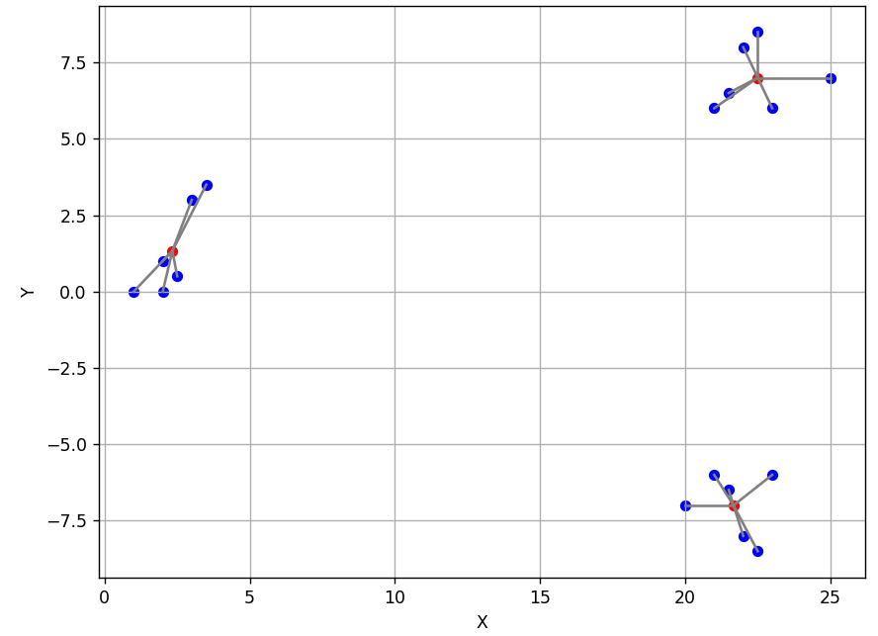
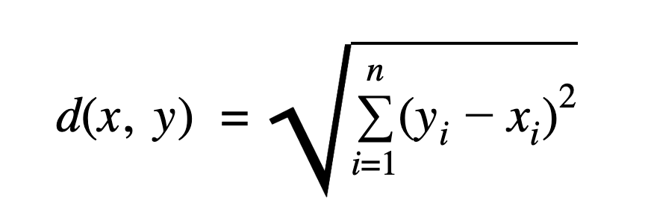
ALGORITHM
The cost is the sum of the Euclidean distance from the medoid, for all the points in the cluster:
Where «n» is the number of the points in the dataset.

Slide 10
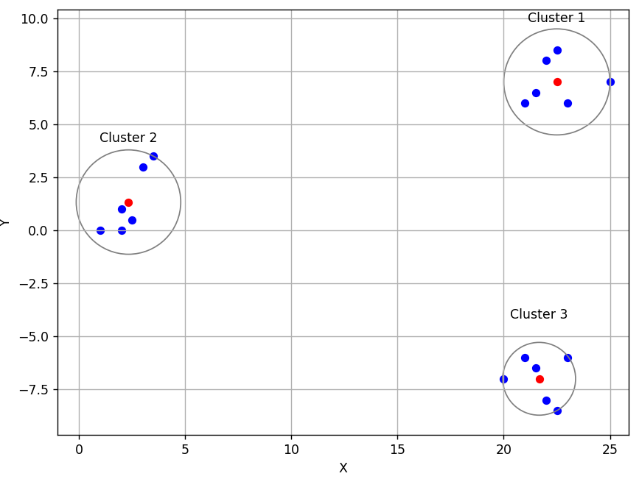
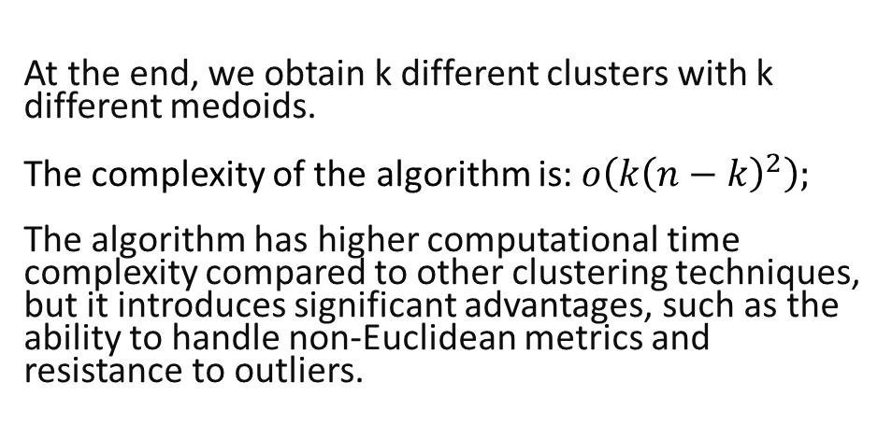
ALGORITHM
At the end, we obtain k different clusters with k different medoids.
The complexity of the algorithm is:$o\left(k{\left(n−k\right)}^{2}\right);$ The algorithm has higher computational time complexity compared to other clustering techniques, but it introduces significant advantages, such as the ability to handle non-Euclidean metrics and resistance to outliers.

Slide 11
2) PARALLELIZATION

Slide 12
HOW TO PARALLELIZE PAM
We have used threads: the dataset is partitioned among threads; each thread processes a subset of points and updates local arrays accordingly.
Threads independently update local arrays to minimize contention and synchronization overhead.
Critical sections are used to ensure proper synchronization when combining local results into global arrays; within these critical sections, a thread compares its local array with the global array that represents the medoids.

Slide 13
3) Execution time e speed up

Slide 14
TOOLS USED
IDE used: Visual Studio Code
Programming language: C++
Performance profiling: AMD uProf, NSight System
Parallelization library: OpenMP

Slide 15
DEVICE CHARACTERISTICS
OS: Ubuntu 22.04
Compiler: g++ with no optimization flag
RAM: 8GB
CPU: AMD Ryzen 7 3700U:
CPU Cores / Threads: 4/8
Architecture: zen+
Frequency: 2,30 GHz (3,50 GHz turbo)
Cache: L1 384KB, L2 2MB, L3 4MB

Slide 16
TIMER
For measuring the execution time, we have used the «chrono» library offered by c++. A steady_clock is a monotonic clock, which means that the time it reports only moves forward.
auto start = chrono::steady_clock::now();
// CODE TO BE MEASURED
auto end = chrono::steady_clock::now(); auto duration = std::chrono::duration_cast<std::chrono::milliseconds>(end - start).count();

Slide 17
EXECUTION RESULTS
We chose to execute the algorithm on five different datasets, each containing 500, 1000, 2500, 5000, 10000 and 25000 points, respectively.
For simplicity, each dataset consists of records representing points in two dimensions only. The test involves clustering the dataset into 5 different clusters.

Slide 18
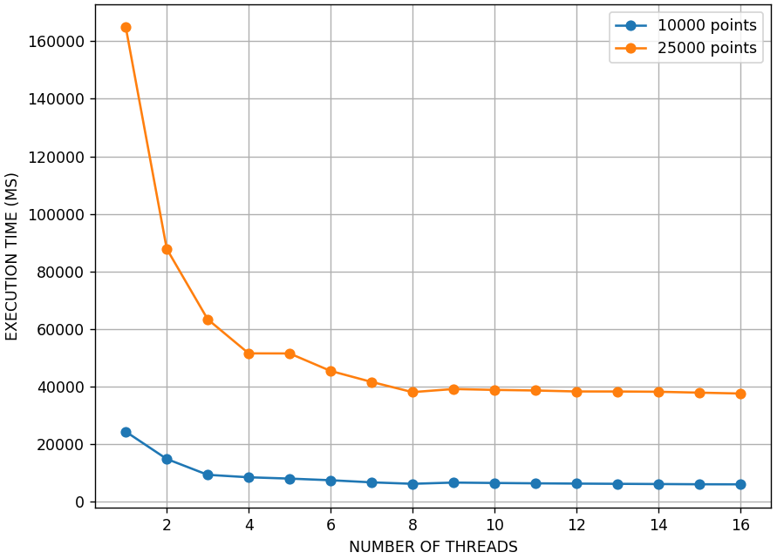
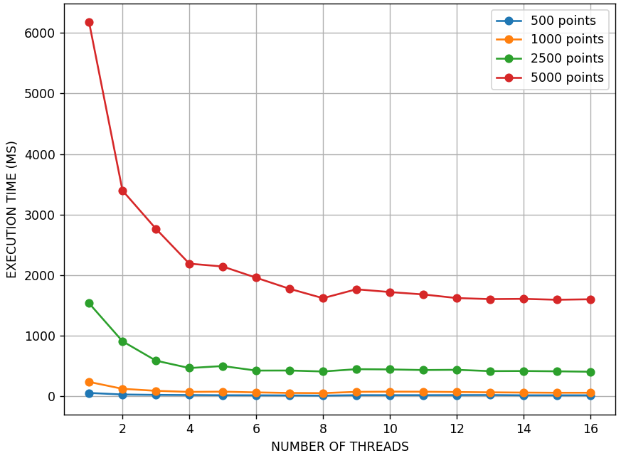
EXECUTION TIME – FIRST VERSION
36 independent trials
Decreasing curve until 8 threads

Slide 19
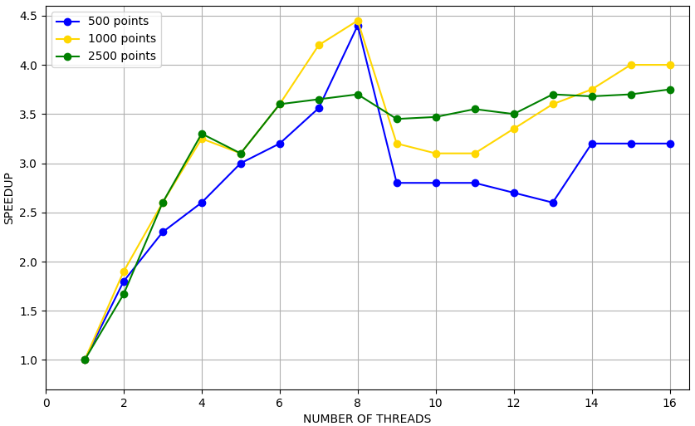
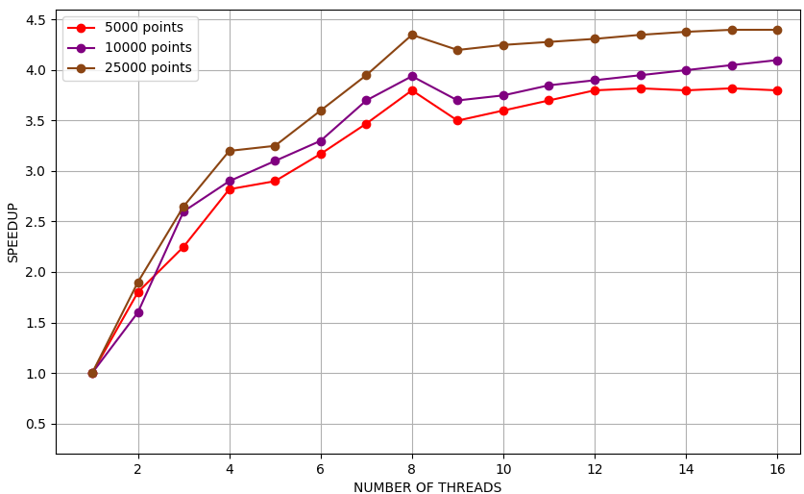
SPEEDUP - FIRST VERSION
Speedup is approximately linear with the number of threads.
Exception: Case with 5 threads
Speedup increases until reaching the number of logical threads in the machine, then decreases.
Maximum speedup: 4.4x with 25000 points.
As the number of points in the dataset increases:
The speedup curve becomes more stable.
Less prone to random fluctuations.
Reflects a more consistent execution time.

Slide 20
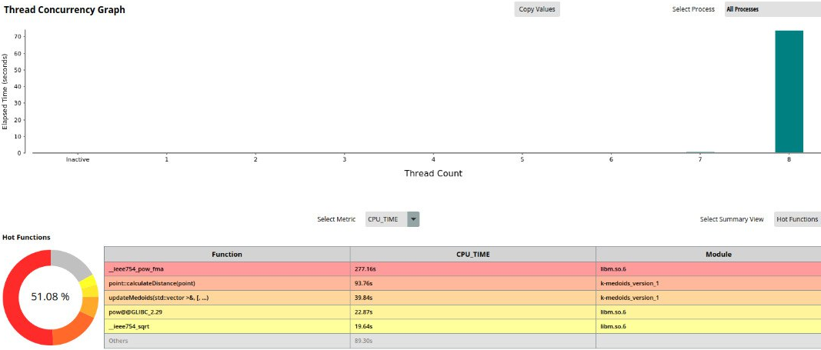
Bottleneck

Slide 21
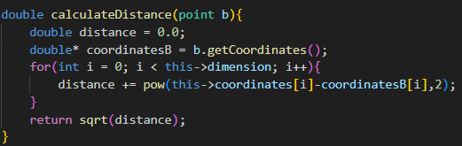
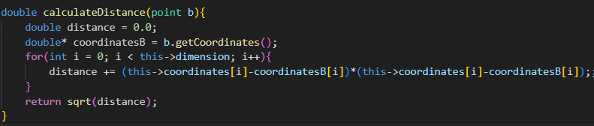
FIRST OPTIMIZATION
We remove the call to the function «pow» because it is very inefficient. Instead, we replaced it with a simpler multiplication between the difference of the coordinates.

Slide 22
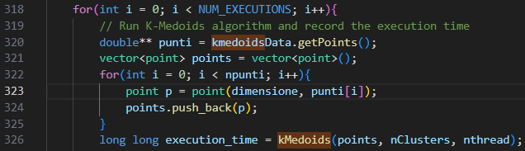
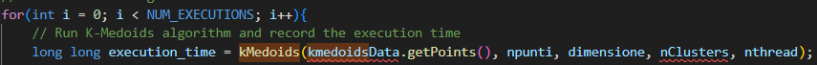
SEC0ND OPTIMIZATION
The use of the «vector» struct slows down the initialization of the main loop in the code.

Slide 23
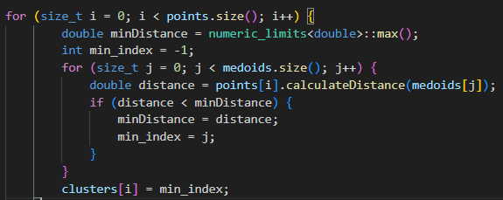
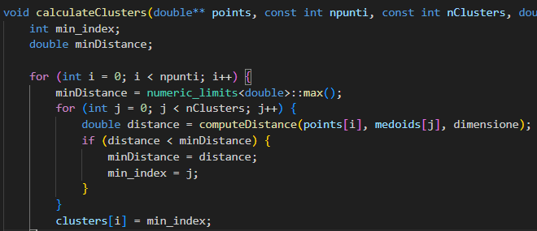
THIRD OPTIMIZATION
In some parts of the code, we optimized method calls and variable declarations inside loops.

Slide 24
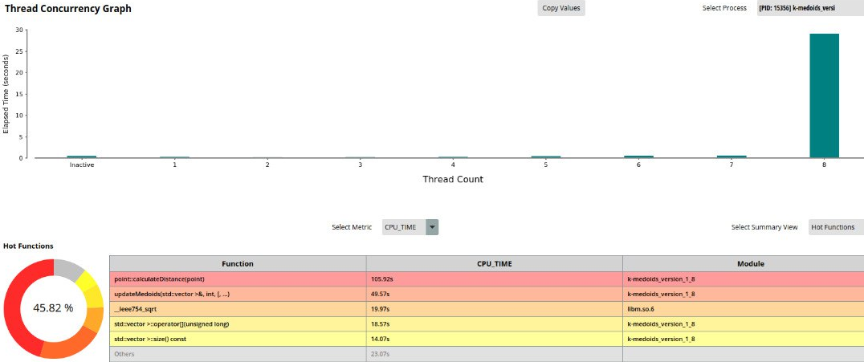
PROFILER

Slide 25
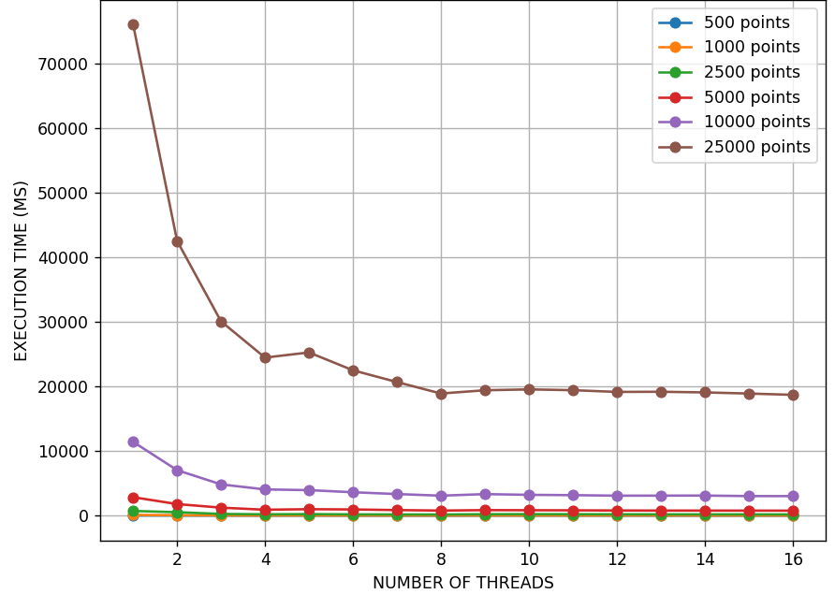
EXECUTION TIME – SECOND VERSION
36 independent trials
Decreasing curve until 8 threads

Slide 26
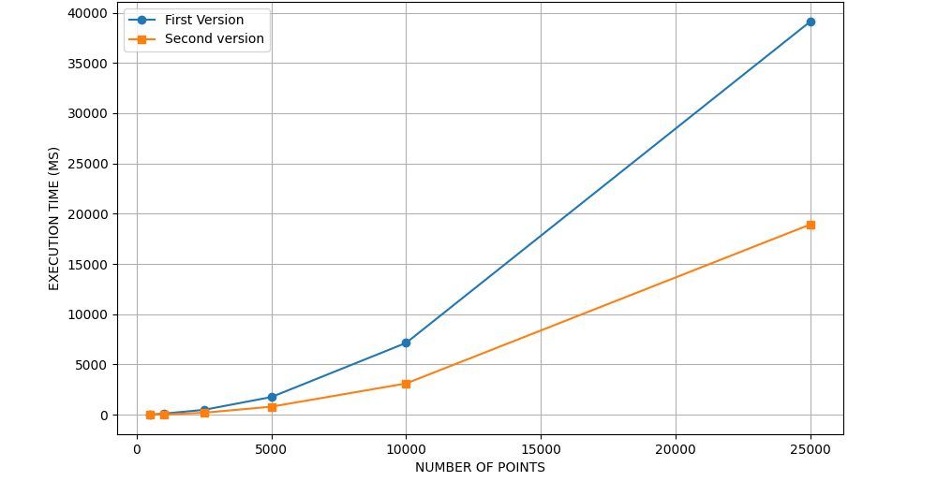
COMPARISON BETWEEN TWO VERSION
Maximum speedup is approximately 2x
The larger the number of points, the greater the benefits of parallelization.

Slide 27
4) GPU VERSION

Slide 28
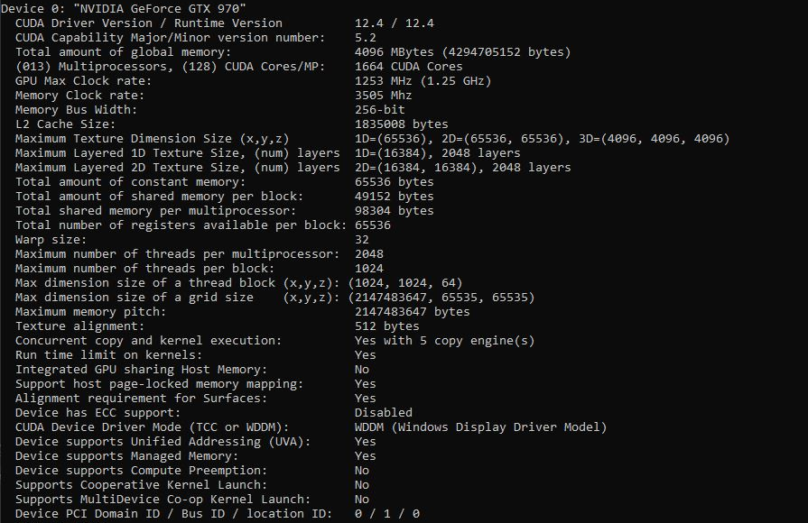
GPU specifications

Slide 29
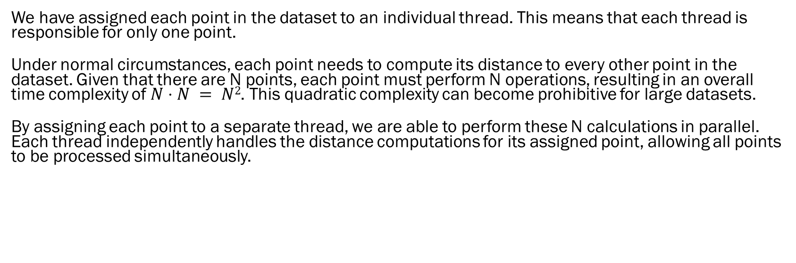
GPU’s implementation of PAM First version
We have assigned each point in the dataset to an individual thread. This means that each thread is responsible for only one point.
Under normal circumstances, each point needs to compute its distance to every other point in the dataset. Given that there are N points, each point must perform N operations, resulting in an overall time complexity of $N⋅N = N2$. This quadratic complexity can become prohibitive for large datasets.
By assigning each point to a separate thread, we are able to perform these N calculations in parallel. Each thread independently handles the distance computations for its assigned point, allowing all points to be processed simultaneously.

Slide 30
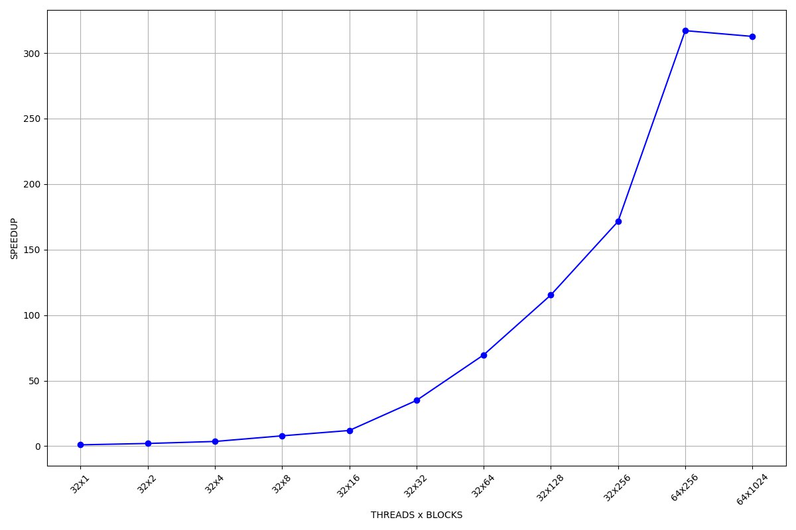
FIRST VERSION
Dataset: 10’000 points, 5 clusters
This version scales up to 64x256 threads per block, because 64x256 is more than 10,000. It scales until it reaches the number of points, which corresponds to the maximum theoretical scalability. After that, the performance does not continue to improve.

Slide 31
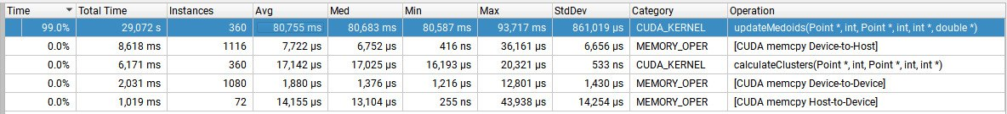
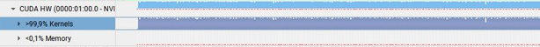
As in the previous CPU-version, almost everything of the time is spent by the «updateMedoids function»
Our profiling analysis shows that nearly all the execution time (99.9%) is spent on the kernels, with only 0.1% of the time being used for memory operations. We are pleased with this result as it indicates that our program is efficiently utilizing the GPU for computational tasks.

Slide 32
GPU’s implementation of PAM Second version
We have assigned each point in the dataset to an individual thread. This means that each thread is responsible for only one point. The problem is that if there are more threads than points, the additional threads stop. This is inefficient. So, the code is great only until I have a number of threads less than or equal to the number of points; otherwise, it stops scaling.
In the second version, every block takes one point, so within the block, the various threads calculate the distance between the block's point and the various points of the cluster. If there are 32 threads per block, all 32 calculate different distances between the block's point and 32 different points of the dataset. It is much more scalable, as performance improves until I have as many points as there are blocks.

Slide 33
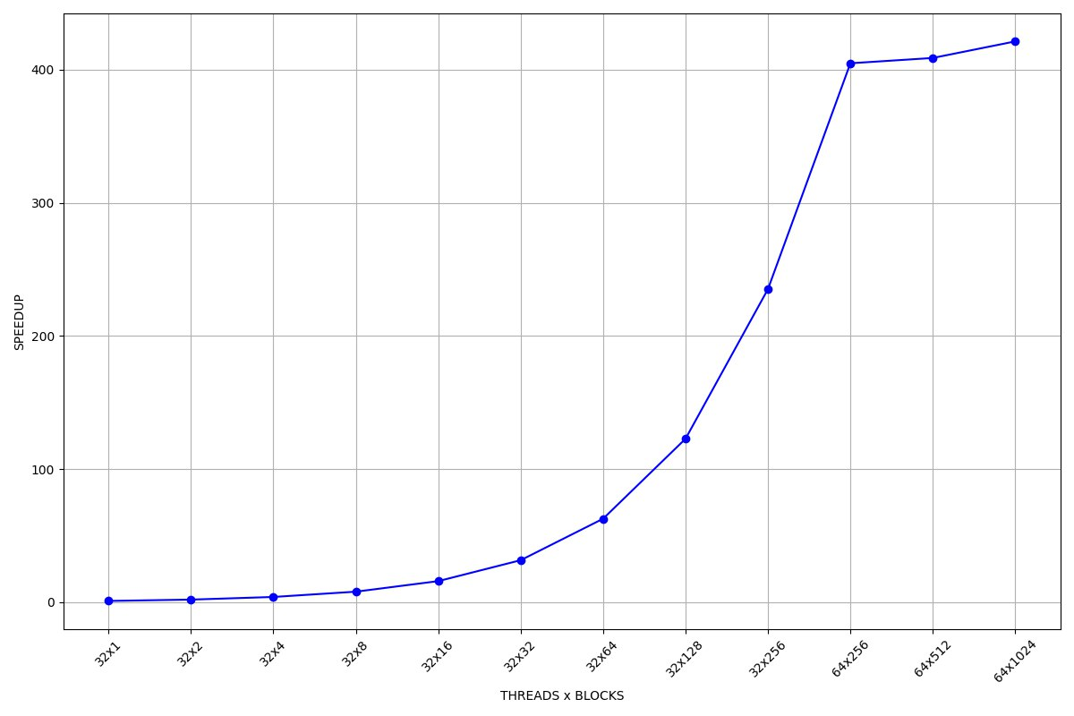
SECOND VERSION
Dataset: 10’000 points, 5 clusters
Second version generally scales better.
It also stops at 32x256, even though it achieves better results (x400 vs x320).
It doesn't stop because the maximum theoretical scalability has been reached, but because the GPU cannot support more threads. The threads are queued, and with too high a number of threads, the queue becomes too large and ends up degrading performance.

Slide 34
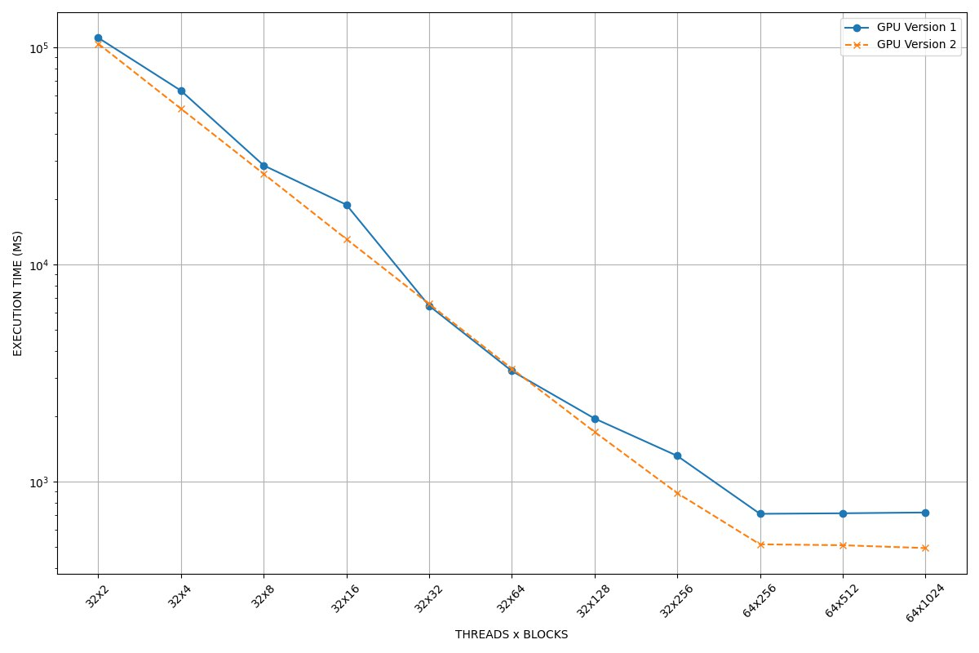
COMPARISON BETWEEN VERSION 1 AND 2 OF GPU
Logarithmic scale for the y-axis.
Dataset: 10000 points.
Almost identical performance for lower number of threads-blocks. Slightly better performance for version 2 in the later stages.

Slide 35
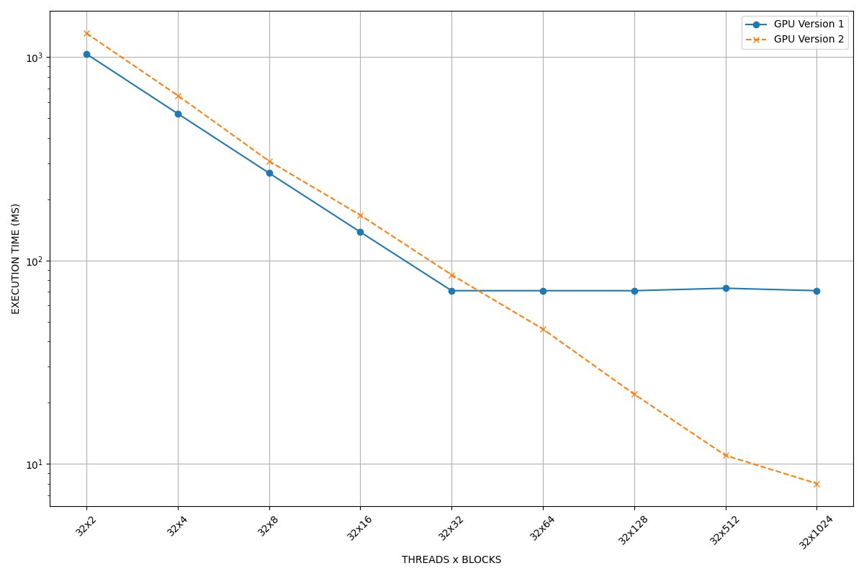
COMPARISON BETWEEN VERSION 1 AND 2 OF GPU
Dataset of 1000 points;
Logarithmic scale for the y-axis;
Version 1 stops scaling almost immediately, at 32x32, as it reaches a total of 1000 threads (maximum theoretical capacity).
Version 2 significantly better results, almost x10 speed up than Version 1.
A more powerful GPU would show the same differences even with more than 1000 points.

Slide 36
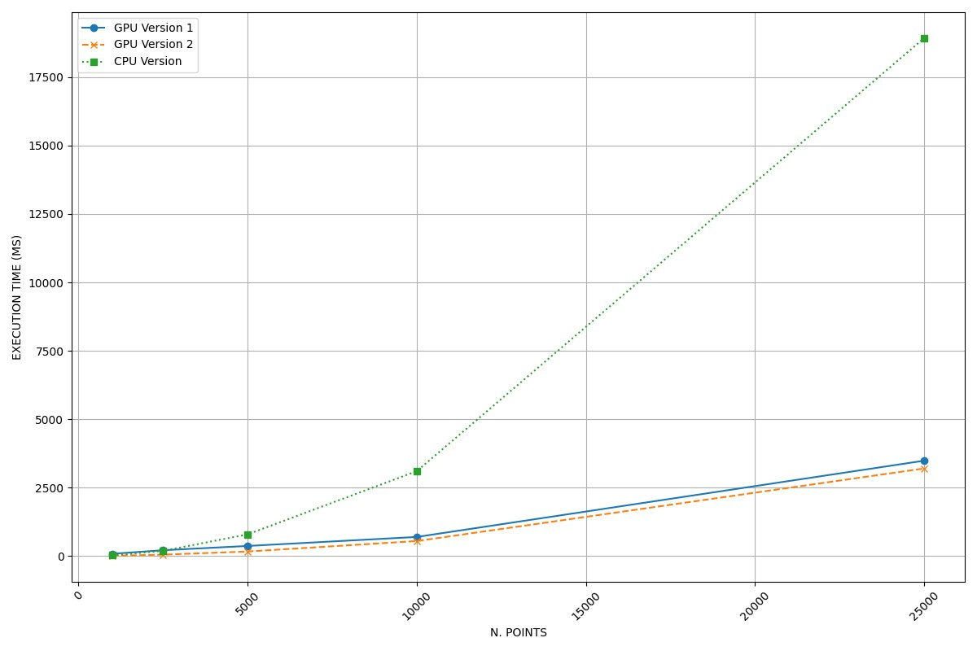
COMPARISON BETWEEN GPU’S AND CPU’S PERFORMANCE
Both GPU version achieve a Speed up of x5.5 with the largest dataset tested.
The two GPU version are significantly better than the CPU version.

